Slide 1
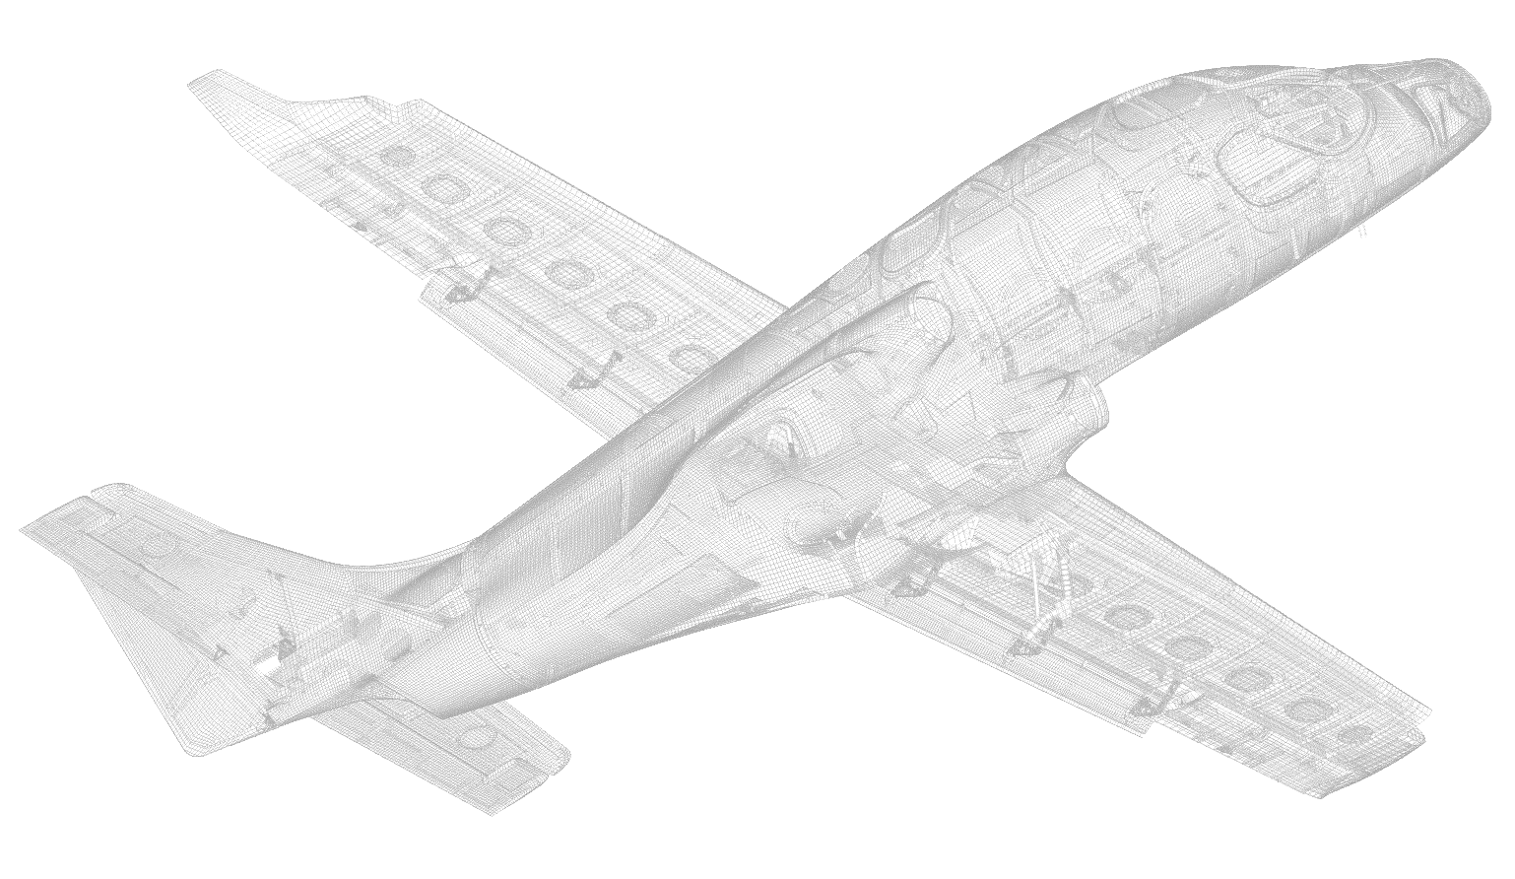
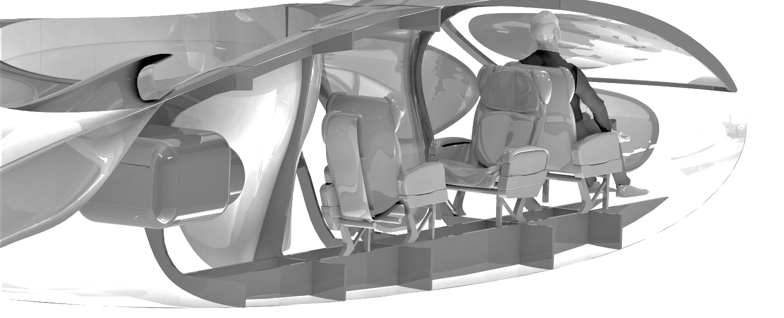
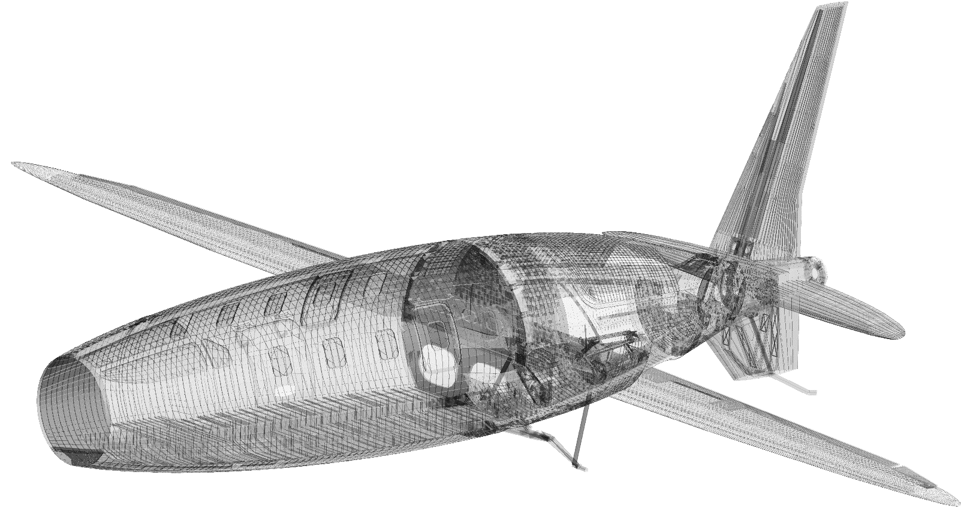
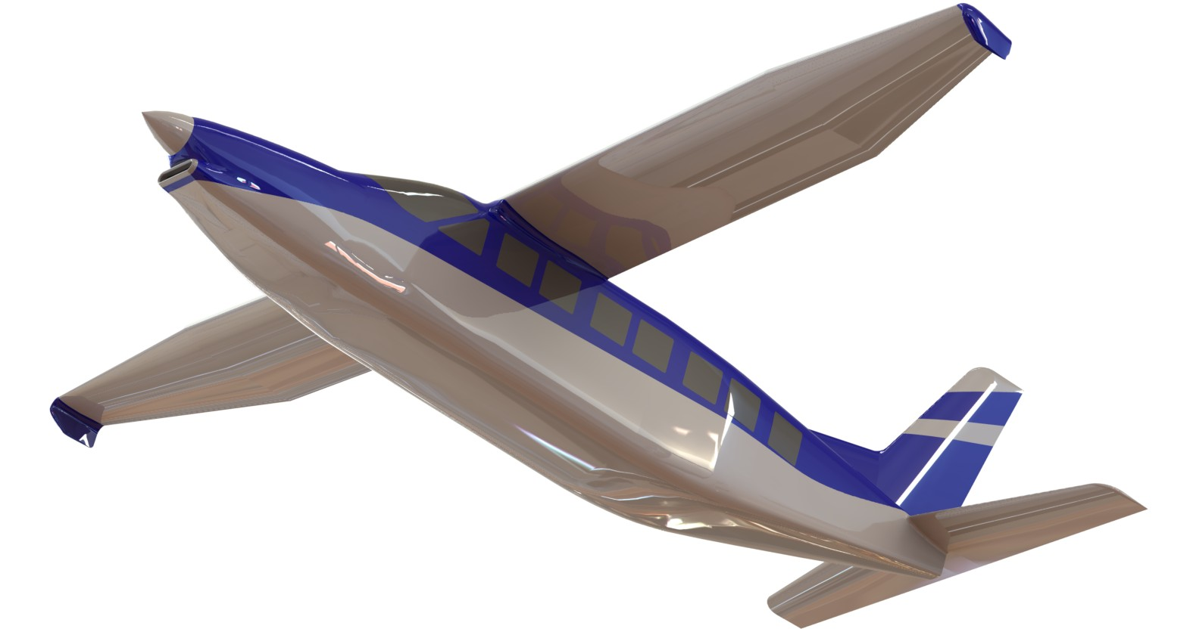
Engineering Risk Management and the 'Conspiracy of Optimism'
Abbott Aerospace
Canada Ltd
www.abbottaerospace.com

Slide 2
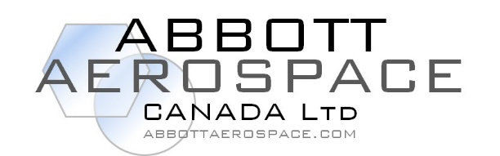
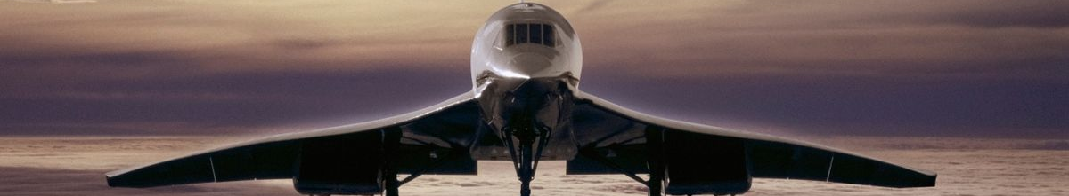
Engineering Risk Management and the 'Conspiracy of Optimism'
Abstract:
When engineers see the phrase ‘Breaking Barriers of the Impossible’ they naturally believe it to apply to the engineering domain and more specifically the technical aspects of the engineering domain. A rational assessment of critical regulatory and commercial risks of product development is crowded out by the enthusiasm of the engineer for a clever technical idea.
The risks of technical failure are usually understood, relatively easy to assess and nevertheless are often underestimated. The risks of regulatory and commercial failure are less well understood, harder to assess and seldom rationally addressed.
This presentation examines why aerospace programs fail and how engineers can better advise managers and company leaders on the actual likelihood of success of a product or program.
David Zimmerman—Getty Images
abbottaerospace.com
Notes:
The abstract, which you can read (I don’t have to read it to you), highlights the objectivity of the technical vs the subjectivity of compliance (more specifically the subjectivity of the individual - delegate or employee of the regulator and their decision making process), and the market.
Compliance problems add to the cost of the program and can significantly impact the commercial viability of the aircraft. If you double the cost of development, (ROI) return on investment and elusive profit are both even more difficult to come by than they otherwise are.
Engineers are often unaware of the financial impacts connected to the choices they make. An increase of the awareness of compliance and commercial implications of the choices made by engineers will allow them to make good technical and commercial decisions.
This can be distilled down to
Any engineering decision that increases certification risk – bad.
Any engineering decision that increases time and cost to market – bad.
Bad technical decisions will almost always cause commercial harm and sometimes good technical decisions can cause commercial harm. A small technical change causing a small product improvement may cause outsized additional costs in certification and time to get to market.

Slide 3
Engineering Risk Management and the 'Conspiracy of Optimism'
Richard Abbott is the president of Abbott Aerospace Canada Ltd and AAV Ltd. He has spent nearly 30 years in military and civil aerospace development. Richard has moved from being a stress engineer to airframe and flight controls leadership and CTO roles. In the last 20 years most of Richard’s work has been with aerospace start up companies in North America.
Richard is the author of a widely used reference book ‘Analysis and Design of Metallic and Composite Flight Vehicle Structures’ and hundreds of engineering analysis spreadsheets that have over one million downloads. Abbott Aerospace hosts one of the worlds largest digital repositories of public domain technical aerospace information at abbottaerospace.com.
Richard has advised, carried out engineering work for, and helped lead many aerospace projects and companies and likely has ADHD, PTSD or both.
abbottaerospace.com
Notes:
As my bio says I have worked in aircraft development for nearly 30 years. Most of that time has been spent working with start up companies. I have been lucky that while my company has worked with start-up companies we also work with established OEMs on initial type certification programs and major supplemental type certification programs.
We manage to not lose touch with the realities and difficulties of certifying an aircraft product even if you are an established OEM with an approved design organization and mature company policies and procedures.
My work is firmly in the part 23 world, with a hint of part 27. This is just as well as (I think) the only start-up company in the part 25 world is Boom Aerospace. They are a great company with a great vision, but being a part 25 Startup is a tough hill to climb.
All of which follows is my opinion based on my experience. With all of the unreliability inherent in eyewitness testimony that comes with viewing the universe through one set of eyes and using one limited brain to interpret it.
I will run through some basic definitions, some fundamental parameters, some historical data, some simple financial models and some recent projects.

Slide 4
Engineering Risk Management and the 'Conspiracy of Optimism'
Definition of Terms
Definition of Engineering:
Engineering is the use of scientific principles to design and build machines, structures, and other items, including bridges, tunnels, roads, vehicles, and buildings. (https://en.wikipedia.org/wiki/Engineering)
Yes……but……something is missing
Definition of Success:
Commercial - ROI – Return on Investment.
Non-Commercial – Complete the mission (not the subject of this presentation)
abbottaerospace.com
Notes:
And so we have to talk about how we define success.
Engineering is regarded as predominantly technical discipline. There is a lot of math, so much that computers have replaced the slide rule, pencil and even the pocket calculator. And all of the interesting math tends to distract engineers from some critical aspects of product development.
If the government wont let you sell it, or people won’t buy it does it matter that you have achieved the impossible?
Engineering in the private sector has to provide a return on investment (or profit to use a simpler term). Successful execution of the technical aspects of engineering are all very well but you do want to get paid and your wage comes out of the profit generated by the products previously developed by the company you work for. Other people have to want to use the products you have developed and they have to want to pay money to use them. You also have to get them though the compliance process to get to market.
The technical aspects of engineering is just a subset, or one consideration, the engineer has to include. The engineer also has to consider compliance issues and development cost amongst others

Slide 5
Engineering Risk Management and the 'Conspiracy of Optimism'
Understanding the Terms – Real world Implications
Engineering:
Developing a product within a development budget that both satisfies a market need and is in compliance with applicable regulations.
Definition of Success:
Selling enough of a demonstrable safe and reliable product at a high enough margin to pay back the development budget (and other associate costs) and provide a profit, or create a return on the investment
abbottaerospace.com
Notes:
I think this is a better definition of the terms on the previous slide.
Engineering must have a safety component and a market component.
i.e. it is bad engineering if it harms people and it is bad engineering if no one wants to buy it, or can’t afford to buy it at a price point that generates a profit
Engineering is product development. It is not a sophisticated theoretical discipline, it is a messy, complex, multi disciplinary process with multiple constraints.
Some of those constraints are (you can probably think up many more):
The laws of physics
The governmental safety standards, or regulations.
Time (Schedule)
Budget
Limitations of your team
Limitation of your managers (we all know we have to manage our managers)
Manufacturing – cost, volume, process variability, security
Market conditions (the available money to buy the product)
Market proclivity (the likelihood of the market buying the product even of they have the money)
Engineering decisions have to acknowledge these limitations.

Slide 6
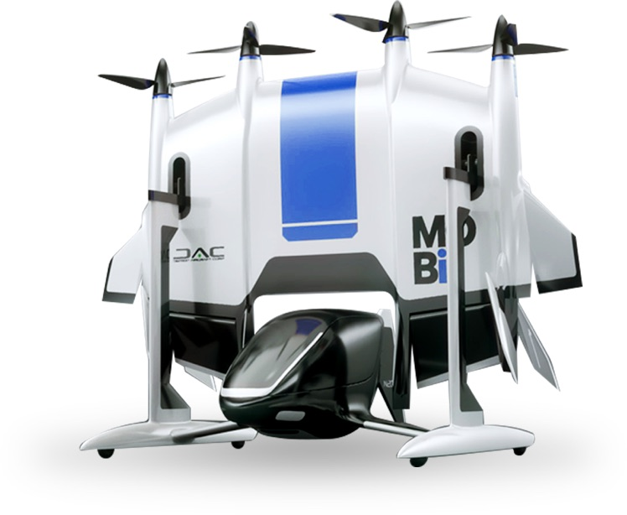
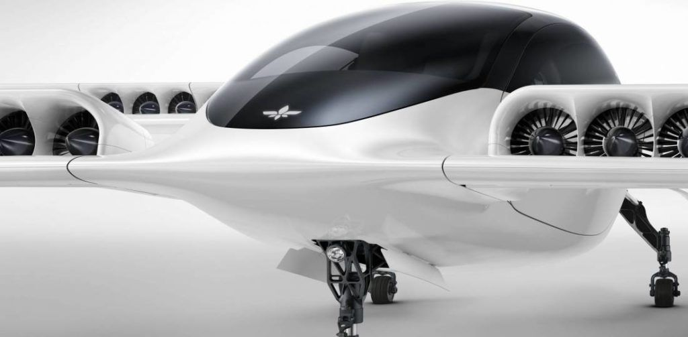
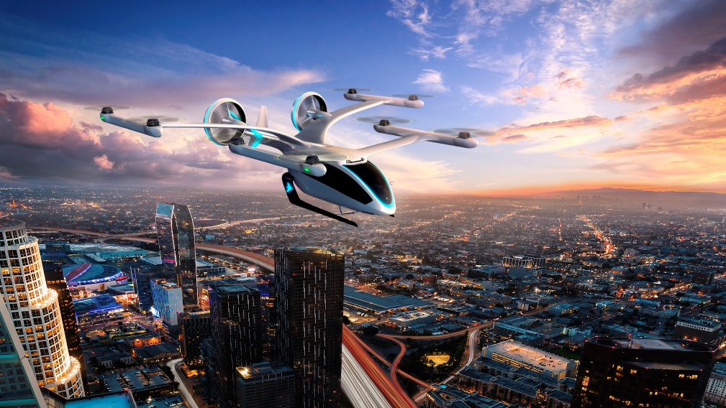
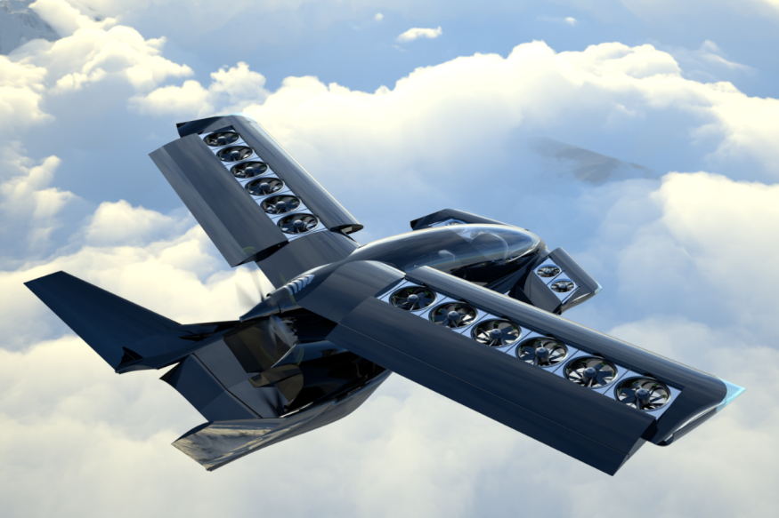
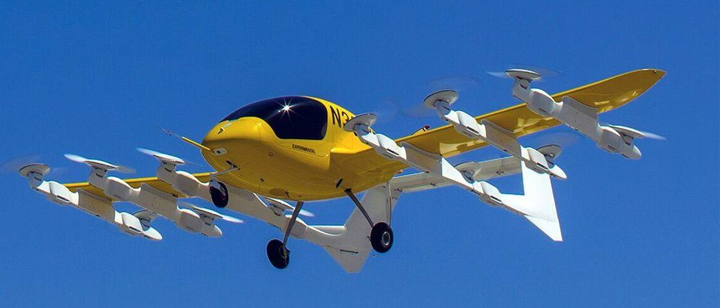
Engineering Risk Management and the 'Conspiracy of Optimism'
Breaking Barriers of the Impossible
The impossible often has a kind of integrity which the merely improbable lacks. – Douglas Adams
abbottaerospace.com
Notes:
The projects on this page have not been selected for any other reason that they represent a cross section of common new concepts and some uncommon new concepts in the eVTOL, RAM domain.
At a surface level we can say they are probably technically viable and that with engineering effort they may all be safe in all flight regimes and modes of operation – tanks to the magic of software driven stability and control.
If direct technical feasibility does not separate these projects then what are the differentiators that will separate the commercially successful projects from the commercial failures?
There may be a difference in engineering effort between the programs shown above but that will not be the critical differentiator between the success and failure of these programs, more critical is the choice of engineering solutions to the technical problems.

Slide 7
Engineering Risk Management and the 'Conspiracy of Optimism'
The Trifecta of Failure Inducing Risk
Technical
Compliance
Commercial
Technical
Compliance
Commercial
Technical
Compliance
Commercial
abbottaerospace.com
Notes:
This leads us to the 3 main categories of Program risks (these are not comprehensive or exclusive of each other but it is an easy way to picture the major risk categories)
Technical is self explanatory – do physics allow it?
Compliance equates to – will the government let me do it?
Commercial means – will enough people buy the product at a price that generates a profit.
Engineers deal largely with the technical aspect – but in the context of the compliance aspect. Some engineers are more aware of this than others.
The question for the project and corporate levels are what are the implications of these risks and how are they mitigated? More specifically How do the technical decisions taken directly impact the technical risks, but also how do they impact the compliance and commercial risk aspects of the program.
Most project and corporate staff are often not in a position to make assessments of how technical decisions will impact the compliance and the commercial risks.

Slide 8
Engineering Risk Management and the 'Conspiracy of Optimism'
Simple Model of Aircraft Development Projects - ‘Flow’ – Commercial Codependences
Engineering
Wage
Design
Technical
Task
Project
Type Certification
Production Certification
Budget
Aircraft Design
Technical Specification
Corporate
Operational
Certification
Aircraft
Aircraft Price
Product Specification
Operators
Fares
Service
Market
Feedback
Customer
abbottaerospace.com
Notes:
There are several ways to think about the relationships in the product development process and some the components necessary for a successful product development to take place.
In the diagram on this slide we define a simple model that describes the relationships between the fundamental financial, information, product and market components.
If any of these are missing the process breaks down.
To repeat some of the earlier points, engineers don’t work for free, companies don’t give away aircraft for nothing and customers pay the airline to fly.
All of the relationships in this model are cooperative and non mandatory. These relationships in a naturalistic, evolutionary way – the relationships in this model are exist because they survive in the technical, regulatory and commercial environments.
(Describe Diagram)
The relationships within the structure can end at any point for any reason,
customers can choose not to travel or select from a number of different options for travel
The aircraft operator can choose to purchase aircraft from a number of vendors
The aircraft OEM can choose which projects they want to fund
And an individual engineer can choose to work for any number of different developers across many types of product all over the world
The success of these relationships depends on responsiveness to the information flow in all the steps and both directions from the customer to the engineer.
This does not show how these activities occur over time – so we will look at that on the next slide.

Slide 9
Engineering Risk Management and the 'Conspiracy of Optimism'
Simple Model of Aircraft Development Projects - Financial Time Line - Commercial
Sales Revenue
Cost/Revenue
Engineering Cost
Manufacturing Cost
Cert Article Manufacture
Cumulative net cash
Production Certification
Break Even Point
ROI
Type Certification
Project End
Total Development Investment Required
abbottaerospace.com
Notes:
This is a simple representation of the time and cost/revenue parameters over time at the OEM. It ignores a lot of other aspects, MRO revenue, upgrades and any ongoing activities to maximise revenue and the life of the product after initial development.
All projects, whether at an established OEM or at a start up company follow this same fundamental process.
You spend money up front, you develop a product, you get the product through the certification process, you sell the product at a profit.
Per our earlier definition, if you sell enough units at a profit, you are a success. If you fail to sell at a profit, or enough units at a profit you will fail.
The commercial aspects of the project rely on a number of key parameters
The first is the total development investment required. This can be generated from a number of sources– existing cash reserves (previous profit), equity transaction or debt.
There second is time to revenue – when does the company stop just burning money on a project and see cash coming in?
The third is when is there a return on investment once all of the up front investment has been covered by the revenue

Slide 10
Engineering Risk Management and the 'Conspiracy of Optimism'
Simple Model of Aircraft Development Projects - Financial Time Line – Commercial
Sales Revenue
Cost/Revenue
Engineering Cost
Manufacturing Cost
Time to Revenue – 5-10 years
A lot of Time
Cert Article Manufacture
Maybe some Money
Cumulative net cash
Production Certification
Break Even Point
ROI
Type Certification
Project End
Definitely a lot of Money
Total Development Investment Required
abbottaerospace.com
Notes:
This is a real simple project model of how this usually plays out in the real world – this is if you get everything right on the technical side.
To have a chance of showing a return on investment there are two things you will certainly need
A lot of money (this is the maximum amount of debut or investment required)
A lot of time
For start up companies this presents a problem. Investors with a large amount of money are hard to find and they always want a return on investment in a short amount of time. The proposition of ‘you give me a lot of money and in a lot of time I might give you a return’ is a difficult sell.
Lets look at some specifics, how much money do you need? How long will it take? What are the likely returns.

Slide 11
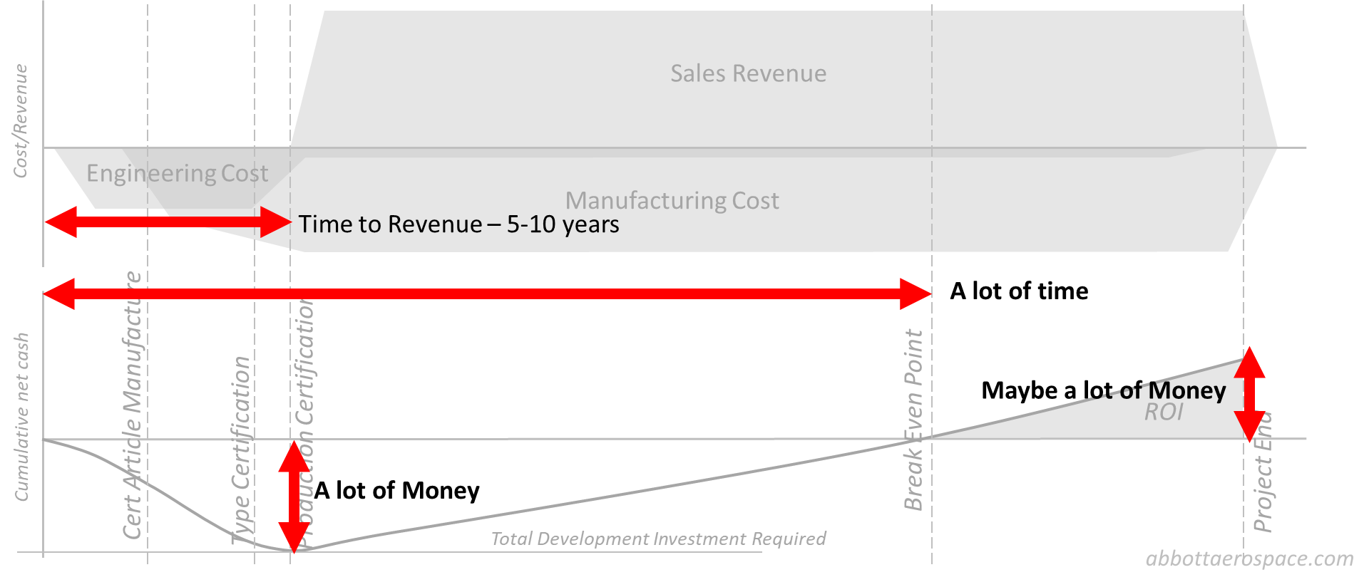
Engineering Risk Management and the 'Conspiracy of Optimism'
Estimated Cost to Get to Market
abbottaerospace.com
Notes:
The next few slides are a set of vague data supported some estimations of recent part 23 aircraft projects. As the slides continue the data becomes more and more ‘exploratory’ – so a word of warning, the numbers do becomes less and less determinate, but the overall drift of the assessment is broadly correct. Feel free to criticize the overall accuracy.
Projects which failed to get to market are shown in red. These are included to ‘flesh-out’ the data and to give a small window on the likelihood of project failure.
This data is collected from various internet sources, some direct experience and talking to lots of people over many years. These costs (as are all of the following costs) are all normalized to 2021 US Dollars using average yearly inflation rate of 3%.
This is the ‘lot of money’ data point from the previous slide
You can see there are some stand out projects who really did well spending a lot of money. This is all very well as long as you sell a lot of product at a reasonable margin, and that is where the problems start.

Slide 12
Engineering Risk Management and the 'Conspiracy of Optimism'
Estimated Time to get to Market
abbottaerospace.com
Notes:
This is the time to revenue component we defined earlier.
The faded red region is the general time it takes for a start up company (or a company engaged in its first type certificated aircraft product – such as companies who have previously product kit aircraft) to get to market. Note that there are established OEMs in this data – Embraer, Pilatus, Cessna, etc.
The timeline to get to market shows the fundamental advantage of being an experienced OEM – reduced time to market and revenue. It also generally follows that the minimizing the time to get to market correlates to minimizing the cost to get to market.
All startup companies face the problem of not having established company systems, supplier relationships, facilities and teams. The absence of these things cause more disruption and delay than people realize
There are some projects who have gone the extra mile in taking their time to develop the perfect product – these projects have proven to be either commercially unsuccessful or rely on a ‘sugar daddy’ corporation or investor to write off the investment cost or be very patient in seeing a return on investment. This is rare and should not be relied upon by the engineering when making technical decisions.

Slide 13
Engineering Risk Management and the 'Conspiracy of Optimism'
Bad Estimation of Total Revenue
abbottaerospace.com
Notes:
The total revenue is the list price multiple by the number of units manufactured.
The first thing to notice is that there is little to no relation between the amount of money spent in development and the amount of revenue generated. This is clearly not good for those companies who spend a lot of money in development.
The simple conclusion to draw is that you should minimize the amount of money spent in development and that translates to, as noted previously, minimizing the time to get to market.
Adopting engineering solutions that can potentially add years to the development program has not historically been related to higher revenues

Slide 14
Engineering Risk Management and the 'Conspiracy of Optimism'
Very, Very Bad Estimation of Total Project Profit & Loss
abbottaerospace.com
Notes:
This slide shows my bad estimation of total profit generated by all unit sold based on an assumed profit margin of 15% total revenue, with the estimated cost of development subtracted from total profit.
These numbers are almost certainly not correct, but they will show some relative comparisons.
From this measure, the outstanding projects (of those surveyed) are the Cessna Mustang, Cirrus SR22, the Embraer Phenom jets, the Pilatus PC-12 and the TBM 700. Of these, one of the projects was developed aby a Startup – the Cirrus SR-22.

Slide 15
Engineering Risk Management and the 'Conspiracy of Optimism'
Assessment of Development Performance - Summary
It is very difficult to get an aircraft through the certification process
It is very difficult to get to make a return on investment
Duh
Why?
What can an engineer do to help?
abbottaerospace.com
Notes:
So it is very difficult. A lot of very smart people have tried and many have failed. The difficulty and cost of certification cannot be overstated
It is very difficult to make a profit because you cerate a return on investment you have to pay back the invested amount, plus interest. Of course the investors can do their best to elevate the company value and make a return by selling shares. But lets avoid that outcome for now
From the preceding data, we can draw the following conclusions, and some of these are pretty obvious – some are less so
The longer you spend in development the more money it costs
The longer the project spends in development and the more money it costs the greater the chance that you will never get to market
The longer the project spends in development and the more money it costs and you get to market the greater the chance that you will not generate enough revenue to make a return on investment.
It therefore follows that the engineer must make decisions to reduce the time to get to market and reduce the overall cost of the program.
Assuming that you are obeying basic physical laws
These decisions must minimize certification risk and therefore the time it takes to get through the certification.
Engineers must minimize manufacturing risk – new materials and processes should be regarded with skepticism.
Engineers must minimize supply chain risk – you should never base a Startup on a Startup.
The bad news is - innovation is the enemy of success. Or, unfettered innovation is the enemy of success

Slide 16
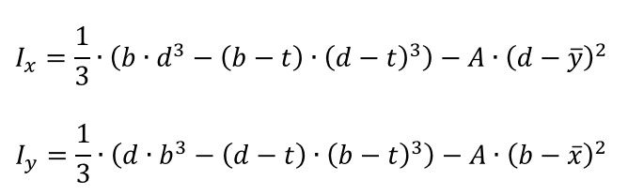
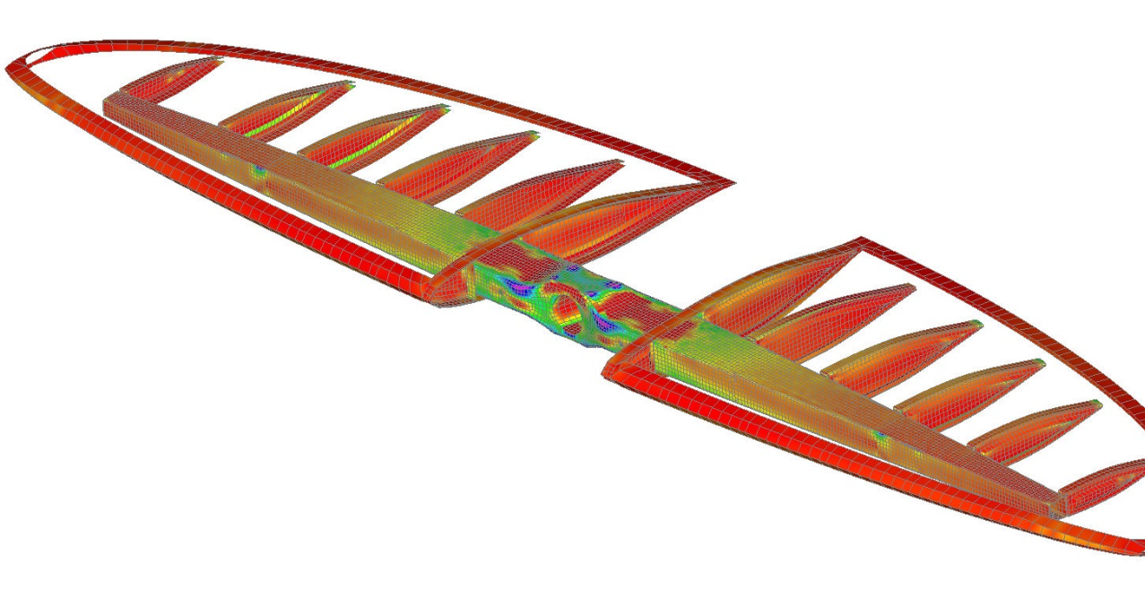
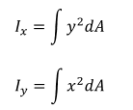
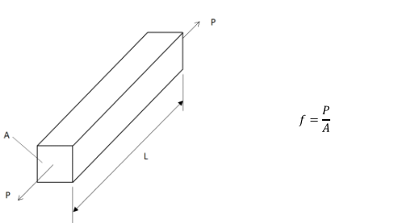
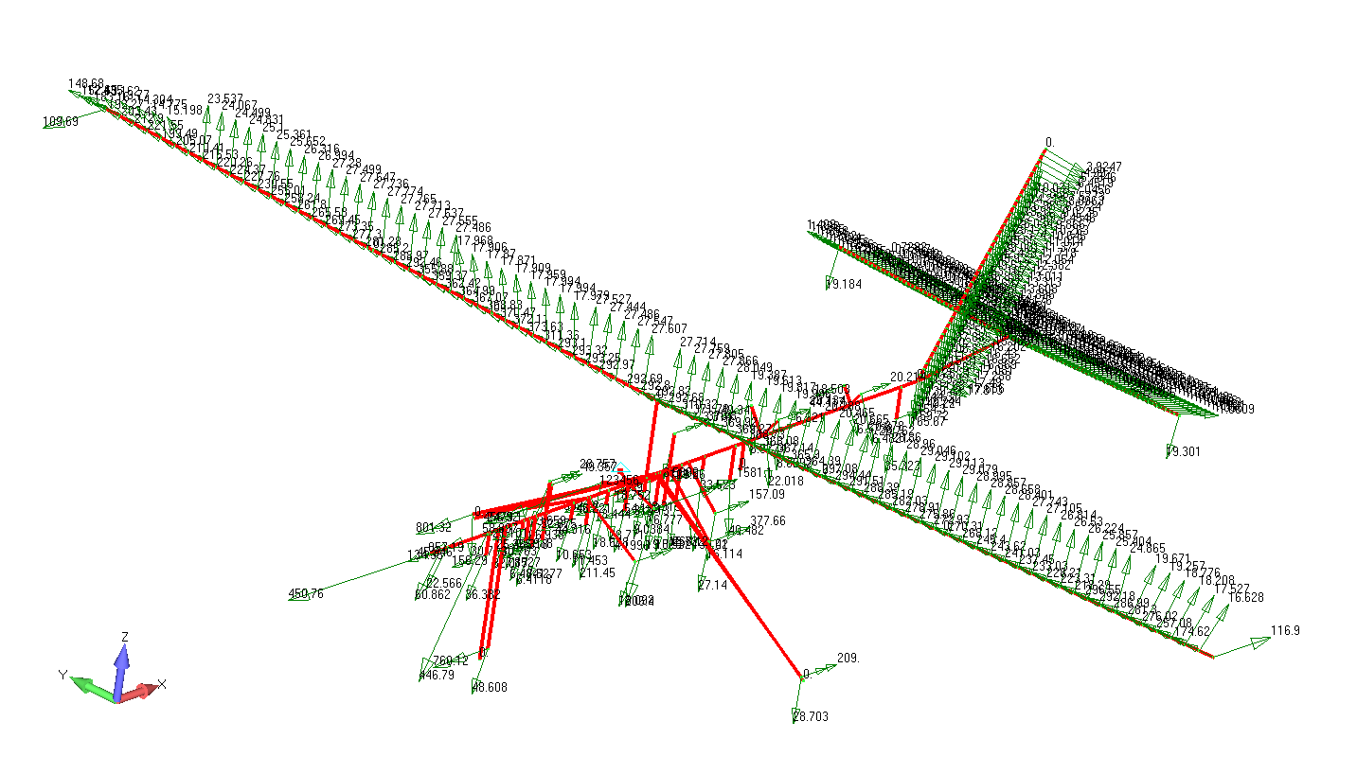

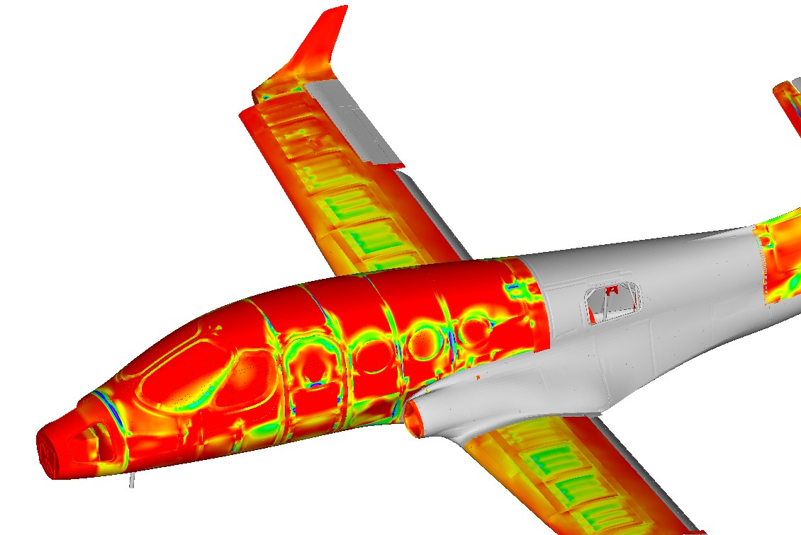
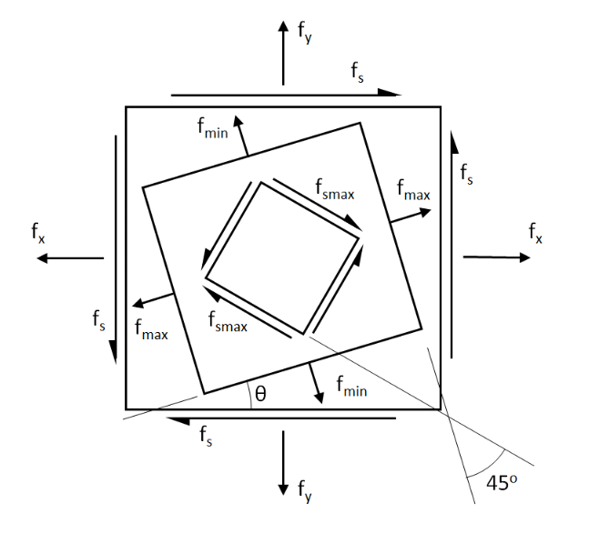
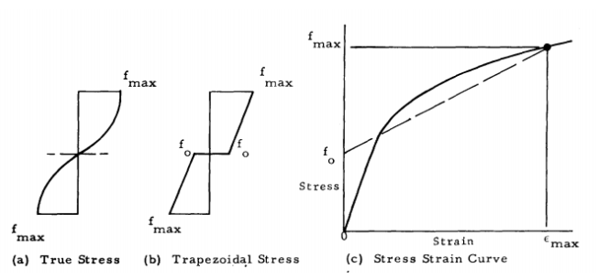
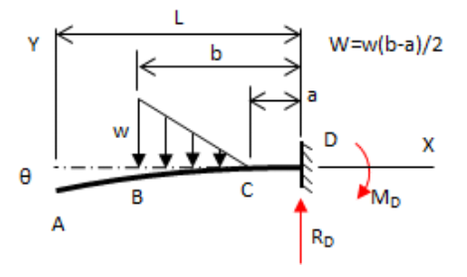
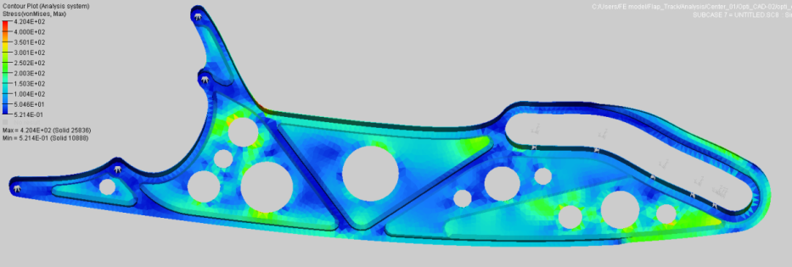
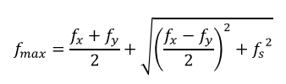
Engineering Risk Management and the 'Conspiracy of Optimism'
Everything is a model
abbottaerospace.com
Notes:
So how do programs go off the rails?
The truth is that many of the programs that end in failure, or to be polite, negative success, are set up for failure from the very start.
Like engineering predictive analysis the financial predictions that are used to plan company activities are based on models.
Models have two fundamental problems
The sewer problem – models are like sewers, you put effluent in and you will get effluent out, even with a perfect model.
A model can be incorrect in terms of the internal predicative methods, a misunderstanding of the limitation of the model methodology or the boundary conditions used when you set up the model.
With structures analysis (my background, so I’ll use this as an example) we have ways to sanity check the model results.
Common Sense – is the result within an order of magnitude of the expected answer?
Validation – running the analysis using different methods – hand analysis, spreadsheets, finite element models
Correlation – doing a physical test and comparing to the analysis results.
The same is true for aerodynamics or system engineering.
When it comes to the financial models life is much more difficult, there is a degree of validation you can do using different methods or historical comparisons but there are few real life tests you can carry out that will confirm the results of your financial analysis. Financial analysis is far more prone to the sin of optimism than technical analysis

Slide 17
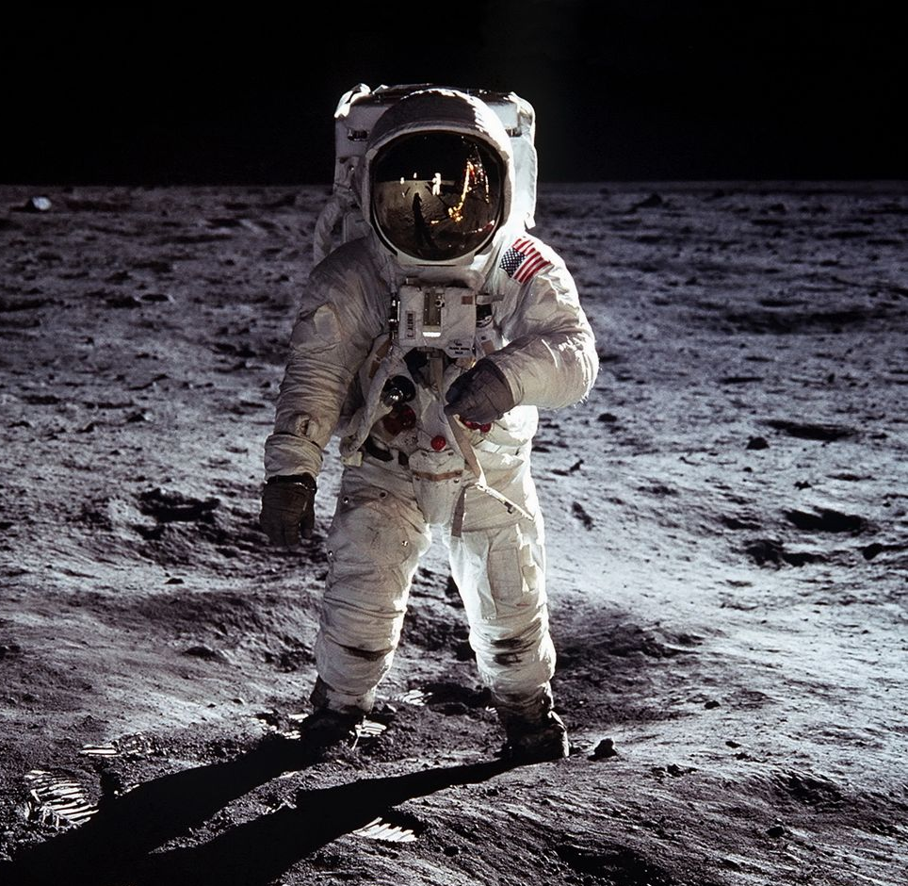
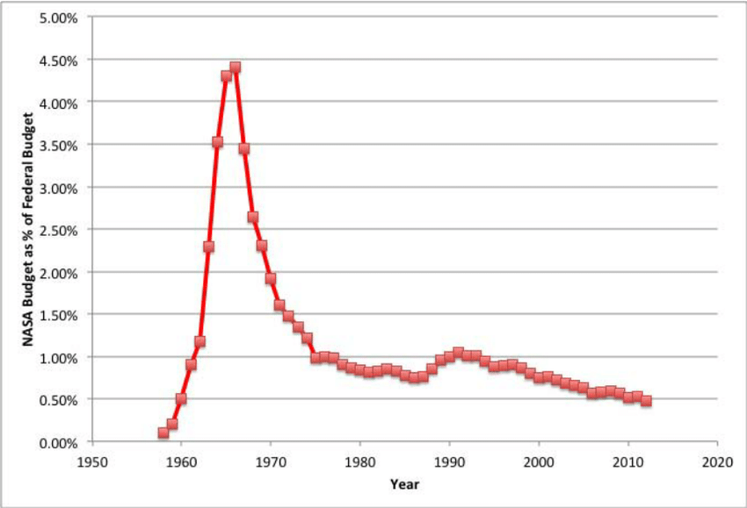
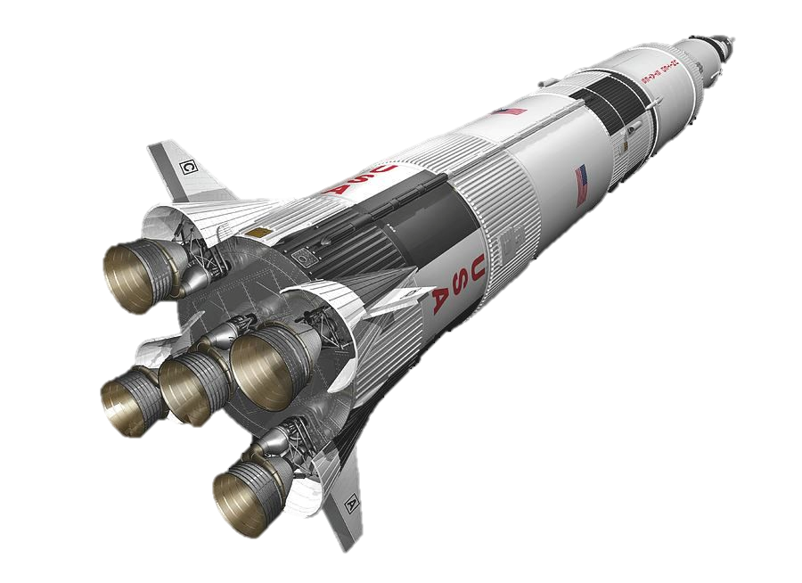
Engineering Risk Management and the 'Conspiracy of Optimism'
Apollo
Government Strategic Policy
Military Program
Government Funded
Little to no regulatory Barrier
Not-for Profit
The Government wanted it
The Military Paid for it
Money No object
FAA? What FAA?
The customer used public money for a project of national interest
But we put a man on the moon………
https://www.researchgate.net/publication/268078377_Space_Shuttle_Case_Studies_Challenger_and_Columbia
abbottaerospace.com
Notes:
Modern aerospace technical development is often compared to the Apollo program – if we could achieve something so phenomenal over 50 years ago…….
If budget, resources and commercial ROI are not limited it is a lot easier to achieve the impossible than people think. The US space program consumed 4.5% of the federal budget at it’s peak. I am not underplaying the achievements of the program. The technological and cultural impacts have been immeasurable.
However it is true that a vast amount of money, great leadership and force of will can make the impossible very possible.
(go through the contents of the slide)

Slide 18
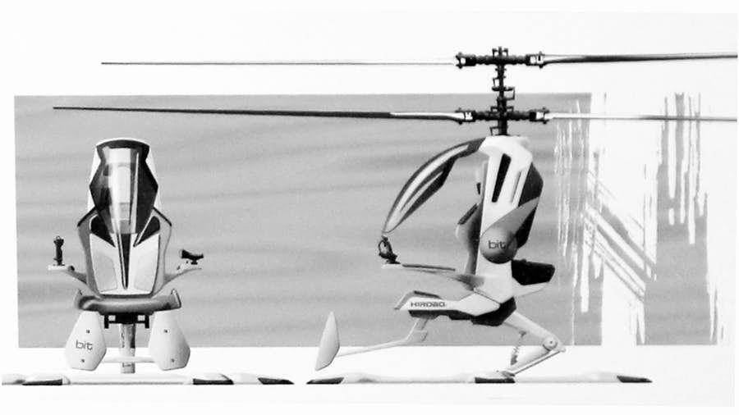
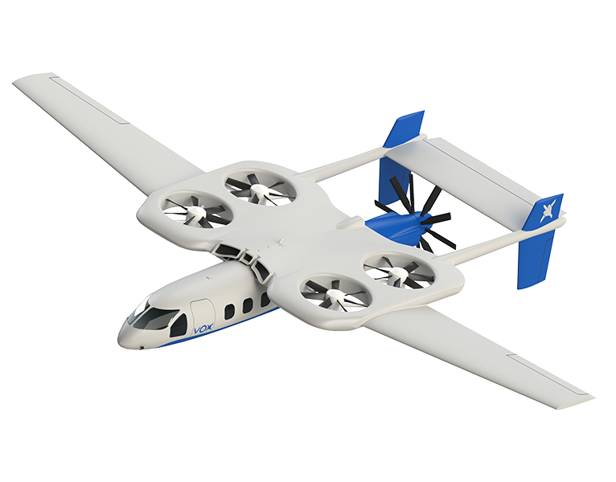
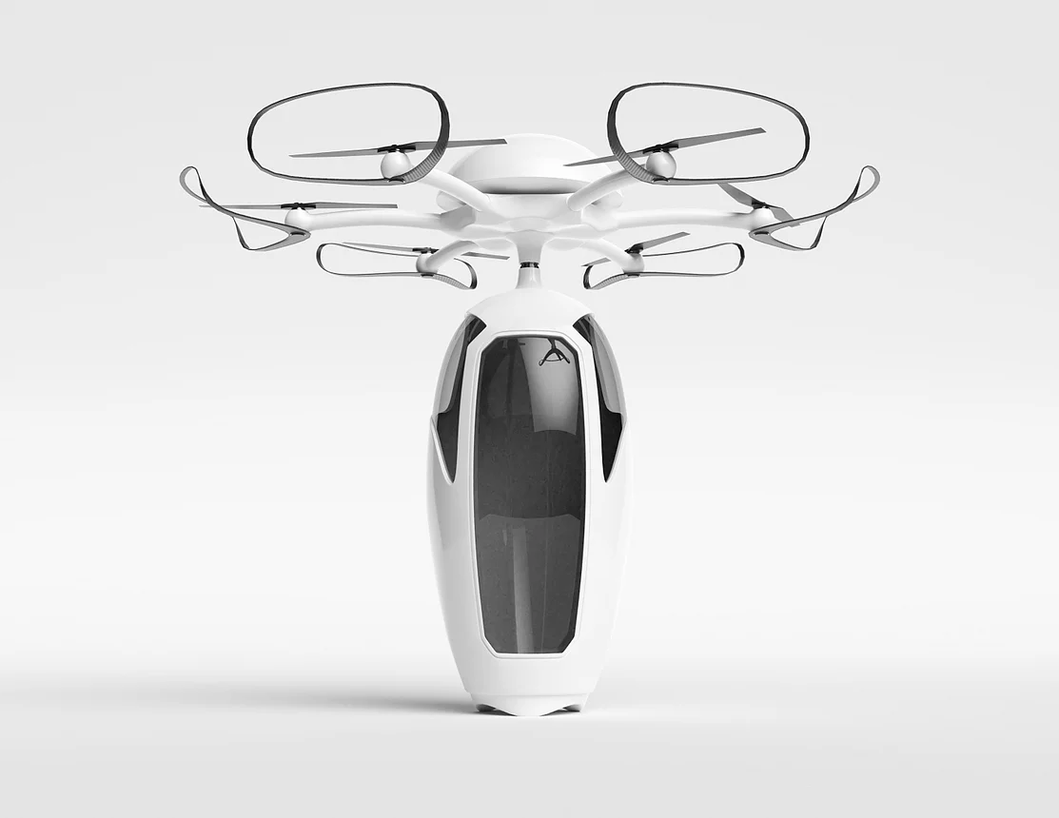
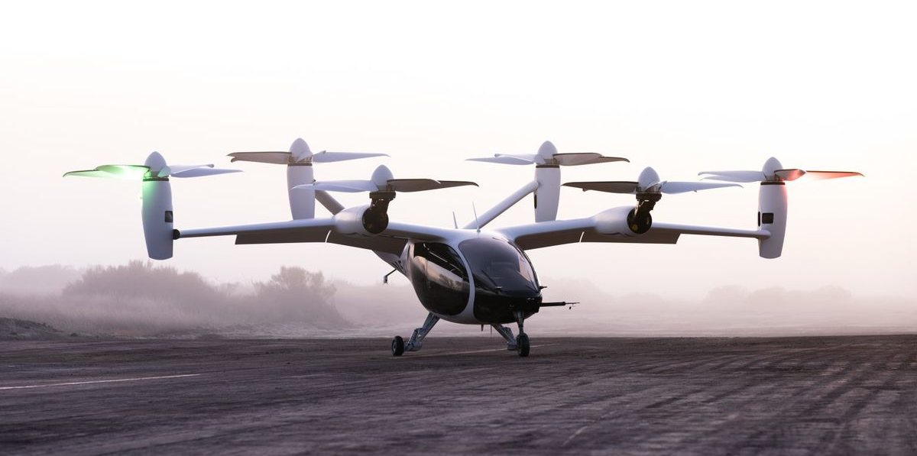
Engineering Risk Management and the 'Conspiracy of Optimism'
But we put a man on the moon………
eVTOL
No eVTOL Government Strategic Policy
No Military Program
Not Government Funded
High regulatory Barrier
Profit
The government does not care
The military does not care
No government Money
Regulations are immature
Private investors require an ROI
abbottaerospace.com
Notes:
If we just the current eVTOL ‘revolution’ from the same point of view.
First of all no one is trying to put anyone on the moon. We are taking customers from their apartment to a restaurant. Or from uptown to downtown. This is certainly more mundane, but is it more or less impossible than putting a man on the moon?
It seems impossible that the skies above the cities of the future will be full of jetson style personal flying vehicles. But we know that the impossible can be made possible with an enormous amount of money, great leadership and force of will.
This is true, Money is not the whole story, if it were, considering the amount of money raised by some high level programs we could be confident their success is assured. However, eVTOLs are not a project that impacts national pride and national security.
The military is not involved (other than tangentially through the AFWERX program, but they are not driving the development in any real way)
They are not funded by the government
The regulatory environment is uncertain and private companies do have to show a profit at some point. And profit is where the true impossibility begins.

Slide 19
Engineering Risk Management and the 'Conspiracy of Optimism'
Financial Models - Ideal
Revenue
$
High Unit Sales/Deliveries
Low Cost of Production
Low cost of development
Low time in development
Cost
abbottaerospace.com
Notes:
The perfect commercial development project consist of the following – and this is obvious but is rarely stated.
Low cost of development and low time to market followed by high unit sales with a low cost of production – or a high margin.
This type of project is an easy sell to either investors or internally in an established OEM. Who would say no to this?

Slide 20
Engineering Risk Management and the 'Conspiracy of Optimism'
Financial Models - likely
Revenue
$
Low Sales/Deliveries
High Cost of Production
High cost of development
Long time in development
Cost
abbottaerospace.com
Notes:
Sadly, this is the reality for many aircraft startups. From data shown on previous slides we can see that, compared to established OEMs, startup companies suffer from a greater time in development and this translates to a higher overall cost of development.
When the companies introduce their product to the market problems with timely scaling up in-house production and supply chain often restricts the sales volumes, this directly affects revenue but also affect economies of scale causing a increase in cost of production of every unit.

Slide 21
Engineering Risk Management and the 'Conspiracy of Optimism'
Financial Models - Worse
Economies
of Scale
Revenue
$
Low Sales/Deliveries
High Cost of Production
High cost of development
Long time in development
Cost
abbottaerospace.com
Notes:
The economy of scale issue can be critical. At a point in time when the expectation from the investors or the parent company is for revenue and profit the unit cost of each produced aircraft can exceed the price charged to the customer.
Making a loss on each produced unit can be further compounded by a companies who have used a poor pricing strategy.
Early on in a startup companies life cycle, or in the project lifecycle inside a large OEM in order to demonstrate the viability of the product, the project starts to take orders.
The more attractively these initial orders are priced at the more orders a project will attract and the more viable it will seem and the greater chance the project has of receiving a green light from external investors or the parent OEM.
The longer the project takes to complete the more the project will cost, this creates a need for a higher price to generate a return on investment
The longer the project takes to complete the greater the inflation between the costing used to generate the price point for the initial orders and the actual cost of production
These issues create the following situation

Slide 22
Engineering Risk Management and the 'Conspiracy of Optimism'
Financial Models – Valley of Death
Economies
of Scale
Pre order
pricing
Revenue
$
Low Sales/Deliveries
High Cost of Production
High cost of development
Long time in development
Cost
abbottaerospace.com
Notes:
This is the perfect commercial storm of aircraft development.
Bear in mind that this scenario assumes that there is a market willing to buy every unit that a project can manufacture. This is not necessarily the case, however it is common that the production rate most Startup companies manage in their first few years of production is so low that selling each unit made is not problematic.
This is the ‘valley of death’ scenario that many projects face after they have fought their way through the certification process. This is especially true of startup companies who do not have established manufacturing systems, who lack effective cost control and have immature supply chain management. These critical manufacturing aspects often fail to get the attention they require during the certification process and are not ready when the company needs to rely on them.
Lets refer back to an earlier slide.

Slide 23
Engineering Risk Management and the 'Conspiracy of Optimism'
Simple Model of Aircraft Development Projects - Financial Time Line - Commercial
Sales Revenue
Cost/Revenue
Engineering Cost
Manufacturing Cost
Cert Article Manufacture
Cumulative net cash
Production Certification
Break Even Point
ROI
Type Certification
Project End
Total Development Investment Required
abbottaerospace.com
Notes:
This is the slide that showed the simple model of a project finances.
It should be noted that the extension of the development schedule always seem to occur when the ongoing development cost is at the highest burn rate. Compliance problems and redesign always seem to occur when you have the maximum number of engineers on the program. You are in the middle of intensive flight test, writing the compliance reports and have a team of designers refining production design and generating tens of thousands of drawings.
You find a problem with demonstration of compliance and it adds 12 months to the program – that 12 months of additional time always seems to happen when you have the highest carrying cost.
The nominal case shown above can easily become…..

Slide 24
Engineering Risk Management and the 'Conspiracy of Optimism'
Simple Model of Aircraft Development Projects - Financial Time Line - Commercial
Sales Revenue
Cost/Revenue
Engineering Cost
Manufacturing Cost
ROI
Cert Article Manufacture
Cumulative net cash
Production Certification
Break Even Point
Type Certification
Total Development Investment Required
Project End
abbottaerospace.com
Notes:
Something that looks like this.
A low manufacturing ramp up leading to a high unit cost required additional investment to carry the company through initial manufacturing.
Of course the manufacturing problems (poor company systems, inadequate facilities, low quality tooling, unreliable suppliers, etc) that prevent the project from getting to higher production volumes require still more investment to fix.
This pushes the break even point even further to the right and this can make break even or ROI a non viable proposition. Non viable in this case means investors walking away or the OEM cancelling the program.
This is a bad thing and can be perceived as a lack of success.
This is not something that you want to include in your initial project plan and present to investors or to your managers. This is often represented by a blanket contingency – some percentage of the overall project budget. It is rarely adequate

Slide 25
Engineering Risk Management and the 'Conspiracy of Optimism'
Financial Models – Happy Thoughts
Profit
$
Development
Schedule
Required
Investment
Manufacturing
Ramp-up
Sales
Volume
abbottaerospace.com
Notes:
Not surprisingly the financial model that you want to present to investors is also the ideal way to run your program.
A short development schedule demanding a relatively small amount of investment
Followed by a quick manufacturing ramp up to a high sales volume.
If we introduce a large amount of innovation into the picture we have a problem. The development schedule becomes longer and more expensive.
The way this can be offset in the financial model is to increase the sales volume. An increase in sales volume, and therefore manufacturing volume, - as we have seen – not only increases the revenue but it makes the project more profitable as economies of scale increase the profit margin on each unit.
The project financial model for ‘modern innovative aircraft projects’ look like the following slide.

Slide 26
Engineering Risk Management and the 'Conspiracy of Optimism'
Financial Models – Happier Thoughts
Profit
Manufacturing
Ramp-up
Sales
Volume
$
Development
Schedule
Required
Investment
abbottaerospace.com
Notes:
The large increase in development and schedule and budgets – which in most projects are accurately represented and are borne out by the amount of investment the leading companies are raising - are compensated for by a faster manufacturing ramp up, higher manufacturing volume and higher sales volume.
Some of the leading projects are forecasting sales volumes in the thousands of units per year. These sales levels are required to show a return on investment.
Theoretically these are good models – I am sure they are internally consistent and mathematically correct.
The success that these models predict for these projects relies on the sales volume.

Slide 27
Engineering Risk Management and the 'Conspiracy of Optimism'
Sales! – The projections
https://www.researchdive.com/166/evtol-aircraft-market
“The global eVTOL aircraft market forecast shall be $4,222.4 million by 2033, increasing from $458.0 million in 2025 at a healthy rate of 29.6%. The North America eVTOL aircraft market is estimated to grow at a CAGR of 31.1% by registering a revenue of $1,283.6 million, throughout the analysis period. Strategic collaborations among the market players along with the launching of advanced eVTOL aircraft services are expected to accelerate the North America eVTOL aircraft market growth.“
https://www.persistencemarketresearch.com/market-research/evtol-aircraft-market.asp
“According to Persistence Market Research’s analysis, the eVTOL aircraft market is projected to expand at more than 21% CAGR from 2021 to 2031.“
https://www.rfdtv.com/story/45093116/eVTOL-Aircraft-Market
“The global eVTOL Aircraft market was valued at 9221.32 Million USD in 2020 and will grow with a CAGR of 8.79% from 2020 to 2027, based on Researcher newly published report.“
abbottaerospace.com
Notes:
Conducting a quick search on line – this was the first hit
The eVTOL market is forecast to increase between 2025 and 2033. Wow. This is great news. It will be growing at a 31.1 CAGR (Compound annual growth rate), or 21.1% between 2021 and 2031.
The eVTOL market was already worth over $9Bn dollars last year!
There are some problems here.
The projections in these reports is for multi billion dollar markets with very impressive and ‘heathy’ year on year growth rates. These are not real and there is no reason to believe they are real
There some pre orders, a very small number of deliveries of small eVTOLs and there is no established market beyond the personal luxury market. This is small. We can refer to historical GAMA data.

Slide 28
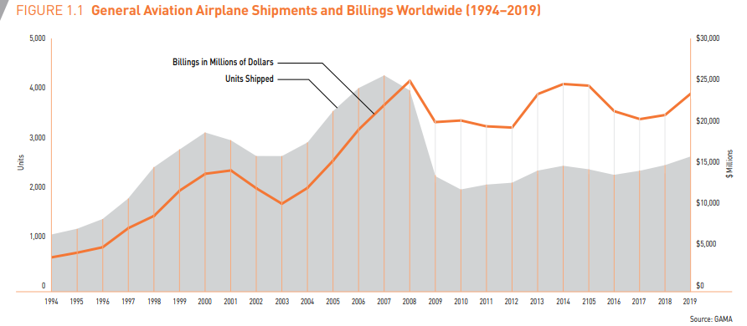
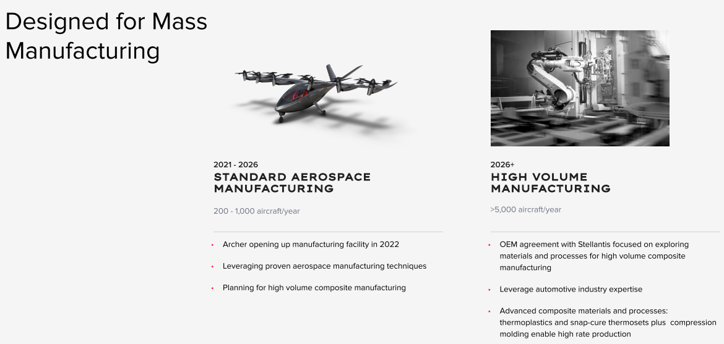
Engineering Risk Management and the 'Conspiracy of Optimism'
How large is the Market?
https://gama.aero/wp-content/uploads/GAMA_2019Databook_Final-2020-03-20.pdf
https://s27.q4cdn.com/936913558/files/doc_presentations/Investor-Presentation.pdf
abbottaerospace.com
Notes:
The above data is for global sales and revenue for all fixed wing General Aviation aircraft – around 2600 units in 2019.
One leading eVTOL project, Archer, in their investor materials show that between 2021 and 2026 they will achieve between 200 to 1000 aircraft per year and in 2026 could be manufacturing over 5000 aircraft per year.
This number is tempered a little on the following slide in their investor deck at the link above that states in 2030 they will producing 2300 aircraft – about the entire 2020 global general aviation market.
Note that it is very open and honorable of Archer to make their investor materials public so I have to give them credit for that. Almost no companies do this.
It is evident that, in order to justify the level of investment required to develop and certify the aircraft, the number of sales and the time to get to a high sales volumes are the parameters that are adjusted to make the financial models work.
Those sales depend on a market is a theoretical projection. This future market will dwarf the current general aviation market. This revenue projection is based on the demand for the product. The demand for the product is based on a demand for the use of the product.
So – who will want to use the product? How do the products compare to alternative modes of transport.

Slide 29
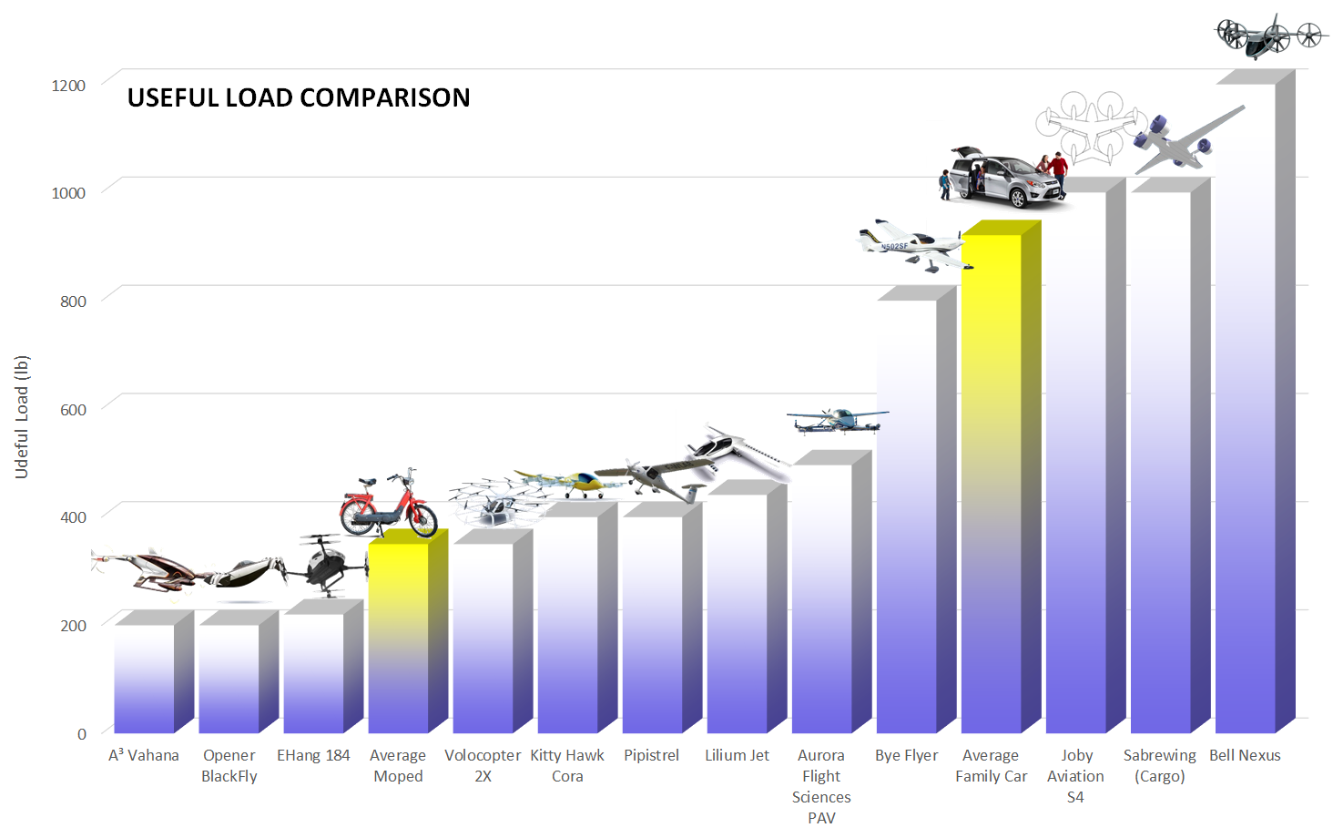
Engineering Risk Management and the 'Conspiracy of Optimism'
Comparison to Alternatives
abbottaerospace.com
Notes:
I created these comparisons a couple of years ago so some of these project. I took a range of eVTOL and conventional electric aircraft projects and compared them to an average family car and an average moped.
In terms of urban mobility these are the available, affordable alternative means of transport.
I used three metrics – Useful load – which is this slide, Range and Cruise Speed on the following slides.
We will talk about cost after we have been through these metrics.

Slide 30
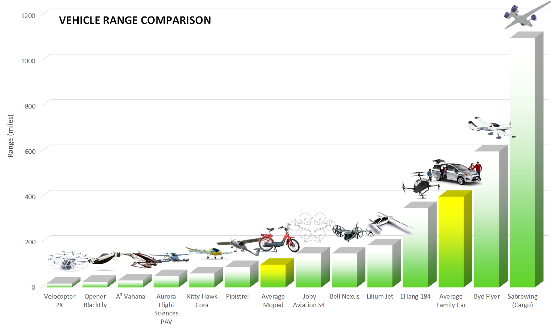
Engineering Risk Management and the 'Conspiracy of Optimism'
Comparison to Alternatives
abbottaerospace.com
Notes:
The range is not favorable when compared to conventional means of transport.
It difference in the means of refueling a car and a moped compared to eVTOL, if we assume gasoline, is widely available and takes a couple of minutes to ‘fill the tank’.
The blackfly opener takes 5.5hours to recharge at 120V and 20A
The infrastructure to deliver adequate power to keep an fleet of hundreds or thousands of flying electric vehicles over an urban center has yet to be fully realized.
If we also just examine power efficiency – a moped typically has a 50cc engine delivering 3 Horsepower – (about 2000 watts) – about half that at cruise – 1000 Watts
Taking the blackfly opener again, from data on their website, the vehicle will consume about 15,000 watts at cruise – 15 times more than a moped.
This does not look like an increase in efficiency

Slide 31
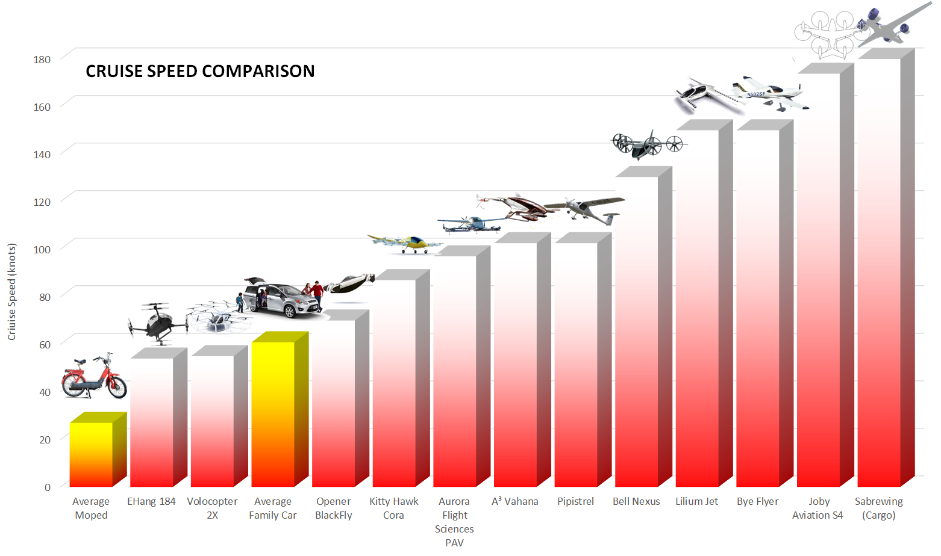
Engineering Risk Management and the 'Conspiracy of Optimism'
Comparison to Alternatives
abbottaerospace.com
Notes:
Speed is where things that fly generally excel.
Not only are they faster, but as they are not bound by reads they have a better chance of making the journey in a straight line.
So they offer one significantly improved metric – that is speed, or time.
The ‘killer’ metric, however is procurement cost

Slide 32
Engineering Risk Management and the 'Conspiracy of Optimism'
Urban Mobility Procurement & Energy Cost.
Type | Specific | Procurement Cost | Cost Factor | Power | Power Factor
One Person | Blackfly Opener | $60,000 | 30 | 15,000W (Cruise) | 15
 | Moped | $2,000 |  | 1,000W (Cruise)
Two People | Archer Maker | $4,000,000 | 133 | 672,000W (Max) | 17
 | Smart Car | $30,000 |  | 40,000W (Max)
abbottaerospace.com
Notes:
I know that urban mobility is predicated on mobility as a service. i.e. you don’t have to buy the vehicle to use it.
But somebody has to buy it – even if the OEM operates the vehicle as a service they still have to bear the cost of production and this has to be accounted for.
The cost of procurement has to be passed on to the user at some point. Either as a direct purchase cost or through a component of the fare charged.
These two simple comparisons are based on the available data and are limited to the projects with available data. The cost of the additional speed the Urban Mobility can offer is clear. But what is the downside?
There is a dramatic increase in the cost of the vehicle and there is a dramatic drop in overall efficiency in terms of power. Even if the journey time is cut by a factor of two or three the amount of of energy consumed (power multiplied by time) will still be many times the amount consumed by the slower, cheaper form of transportation.
This does not look like a very green way to travel.
Considering the cost of insurance, the higher safety standards required for air operation (and the associated cost with those standards) and the obvious difference in the cost of procurement, the overall cost to the customer is not going to be lower than for land based travel.
How much will people be willing to pay in both cash and energy inefficiency to reduce their journey time?

Slide 33
Engineering Risk Management and the 'Conspiracy of Optimism'
What is an engineer to do?
Acknowledge commercial Reality:
Risk = development cost & development time
Innovation = risk
Innovation = development cost & development time
Increases in development cost and time to market will harm the commercial potential of the product.
abbottaerospace.com
Notes:
Adding technological risk to a program not only affects the technology aspects.
The cost and time to show compliance with regulations will also increase.
Technological risk often introduces new forms and features to the market and the market can be both surprisingly conservative and fickle.

Slide 34
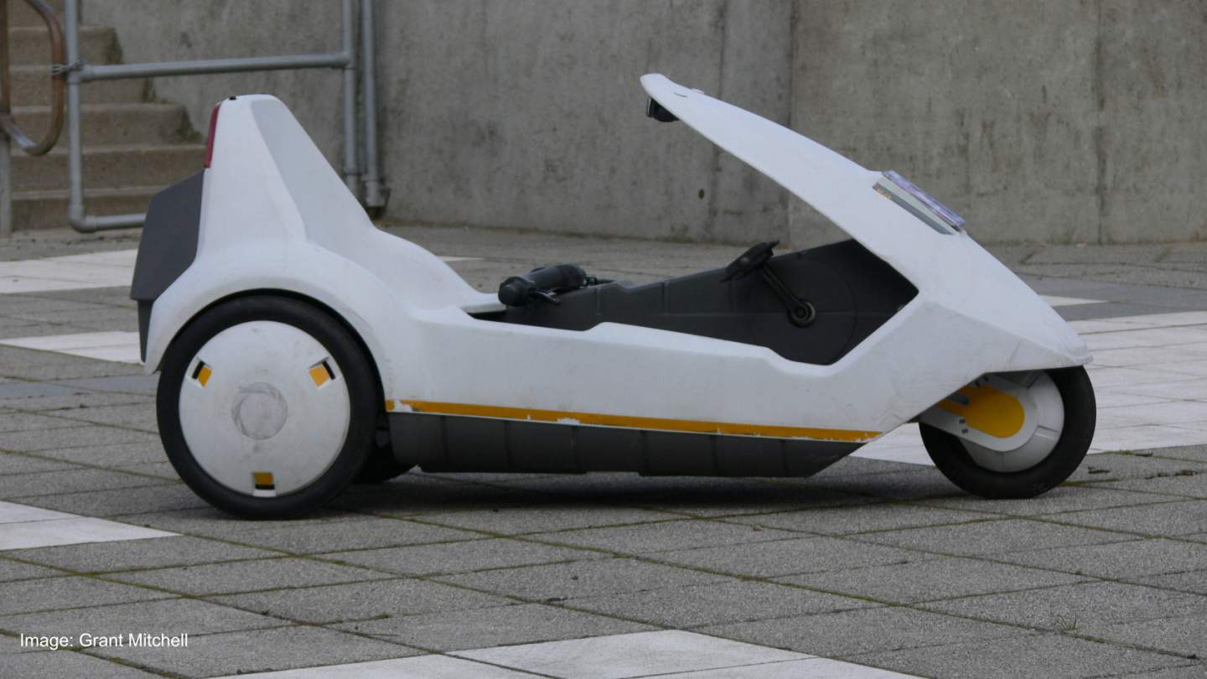
Engineering Risk Management and the 'Conspiracy of Optimism'
What is an engineer to do?
Do not be optimistic. Never ignore risk.
Always Reduce Risk
Always Reduce Innovation - to the minimum necessary to meet the mission
Do not trust that your managers understand the technical risk.
Do not trust that the regulator understands the technical risk.
You may be the only person that understands the technical risk
abbottaerospace.com
Notes:
Optimistic engineers make me nervous.
So – whatever the downside aspect to a technical risk you have to assume that all negative aspects of the risk will manifest themselves – they almost always do.
As an engineer you may be the only person that understands the technical risk on a program. How good are you at communicating that risk to your manager?
The regulator will not understand the risk. Presenting an overview in an initial type board meeting to the regulator or addressing the compliance issues in more details in the compliance plan is not going to address all of the risks and all aspects of the risk.
For example – working with a new supplier on the integration of a prototype version a new innovative component is interesting and exciting. It does not mean that the supplier can ramp up to manufacture hundreds or thousands of unit per year and consistent meet quality standards. What will you do if they fail to meet their obligations. How can you make better decisions to mitigate supplier risk?

Slide 35
Engineering Risk Management and the 'Conspiracy of Optimism'
What is an engineer to do?
Unmitigated Risk turns Good Ideas into a Bad Ideas
Optimism Ruins Programs
Raising Capital does not Mitigate Risk. It Heightens Risk.
Making the impossible happen is possible, but people may not want to buy it.
In the end the Market will decide.
"Der mentsh trakht un got lakht”
(Man Plans, and God Laughs)
Plans are useless, but planning is indispensable. – Eisenhower
abbottaerospace.com
Notes:
I will finish with some useless contradictory wisdom. Some of which is mine (the useless bits) and some of which some from much cleverer people.
Many good ideas have been ruined by failing to mitigate the obvious risks
Optimism is for salesmen and elementary school teachers.
Raising Capital by itself does not mitigate risk. It creates the means to pay for risk mitigation activities. If you have to raise billions of dollars to mitigate risk you may have taken on the wrong risks and in general the engineering activities will expand to consume the available budget. The more capital you raise the more you have to sell at a higher price to keep the investors happy.
Humans have achieved many impossible things, not all have been useful or marketable

